Slide 1





AI-Powered Resume Ranking System
Name: Dipanshu Dhage
Email Id: dipanshu9131@gmail.com
Guide: Saomya Chawdary

Slide 2

AI-Powered Resume Ranking System
OUTLINE
Abstract of the Project
Problem Statement
Proposed Solution
System Architecture
Live Demo of the Project
Embedded Video of Project
Conclusion
Future Scope

Slide 3

Abstract Of The Project
AI-Powered Resume Ranking System
It’s a automates resume screening using Artificial Intelligence (AI) and Natural Language Processing (NLP) to improve efficiency, accuracy, and fairness in hiring.
1] Challenges in Traditional Hiring:
Manual resume screening is time-consuming and biased.
Qualified candidates are often overlooked.
High workload for recruiters
2] Proposed Solution:
Uses OCR & NLP to extract key details from resumes.
Compares resumes with job descriptions using AI-based ranking.
Provides bias detection to Ensure fair selection.
3] Key Benefits:
Reduces hiring time by 50%.
Enhances accuracy & fairness in candidate ranking.
Scalable & adaptable for corporate, staffing agencies & government hiring.

Slide 4

Problem Statement
AI-Powered Resume Ranking System
1] Challenges in Traditional Hiring:
Manual resume screening is time-consuming and inefficient.
High chances of bias in candidate selection.
Qualified candidates are often overlooked due to human errors.
HR teams struggle to process large volumes of resumes efficiently.
2] Need for an AI-Powered Solution:
Automate resume screening to reduce hiring time by 50%.
Improve accuracy and fairness in candidate selection.
Ensure unbiased, data-driven hiring decisions.

Slide 5
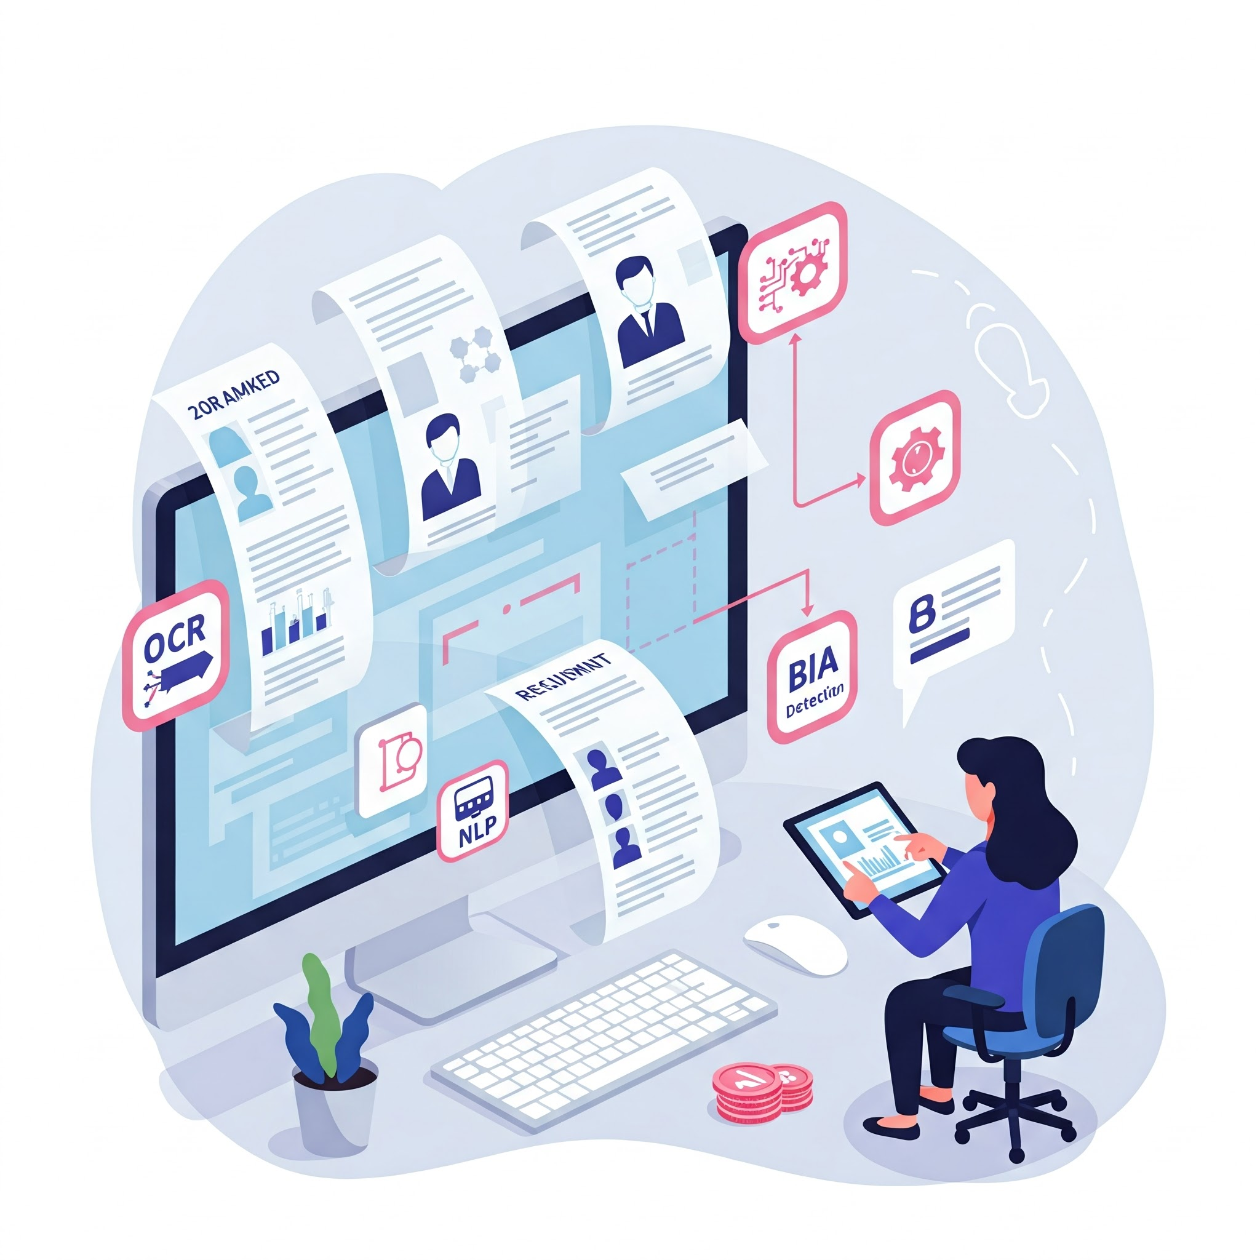
Proposed Solution
AI-Powered Resume Ranking System
The AI- Powered Resume Ranking System automates resume screening using AI & NLP, reducing manual effort and improving hiring efficiency.
1] How It Works:
Extracts resume text using OCR & NLP (PDF/Image).
Analyzes skills, experience, and education using AI.
Compares resumes with job descriptions using BERT-based ranking.
Identifies bias to ensure fair and unbiased selection.
2] Proposed Solution:
Reduces hiring time by 50%.
Improves accuracy in candidate-job matching.
Ensures a fair and efficient recruitment process.

Slide 6
System Architecture
AI-Powered Resume Ranking System
INPUT
STAGE
PROCESSING
STAGE
OUTPUT
STAGE
Resumes (Uploaded by users)
Job description (Entered for comparison)
Text Extraction
Features Extraction
AI Model (BERT-based)
Bias Detection Module
Ranked resumes
Diversity & Bias Analysis Report
Final Shortlist

Slide 7
Live Demo of Project
AI-Powered Resume Ranking System

Slide 8
AI-Powered Resume Ranking System
Video of Project Demo

Slide 9
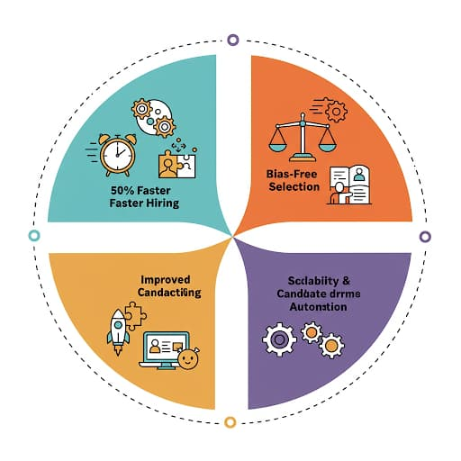
Conclusion
AI-Powered Resume Ranking System
AI-Powered Resume Ranking System enhances hiring efficiency by automating resume screening using AI & NLP.
Reduces hiring time by 50% while ensuring accurate and fair candidate selection.
Eliminates bias through AI-driven diversity and fairness checks.
Improves candidate-job matching with BERT-based ranking models.
Scalable solution for corporate hiring, staffing agencies, and government recruitment.

Slide 10

Future Scope
AI-Powered Resume Ranking System
Integration with Applicant Tracking Systems (ATS) to streamline HR workflows.
Multilingual resume processing for global hiring and diverse applicant pools.
Real-time resume feedback system to help candidates improve their profiles.
Advanced bias detection algorithms for even fairer hiring practices.
AI-powered interview scheduling and automated candidate engagement.
Cloud-based system scalability for large enterprise and government hiring needs.

Slide 11
AI-Powered Resume Ranking System
Thank you!
Notes:
11

